Slide 1
CS/IT BSc Projects
Ubiquitous Computing and Interaction

Slide 2
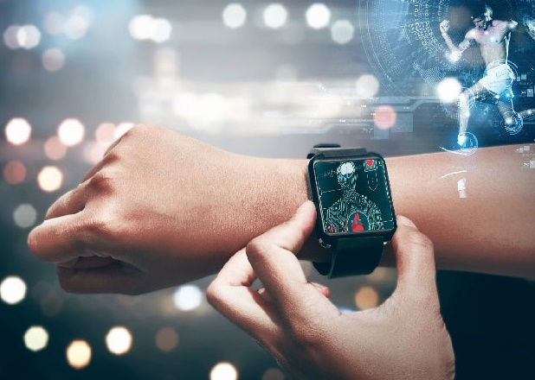
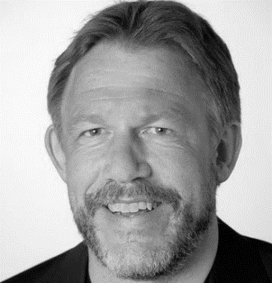
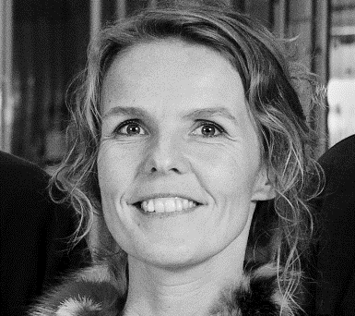
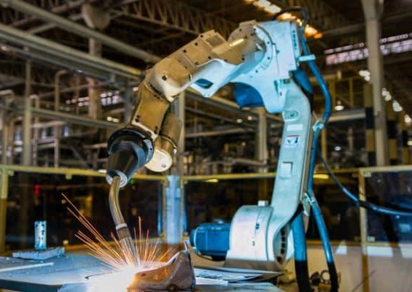
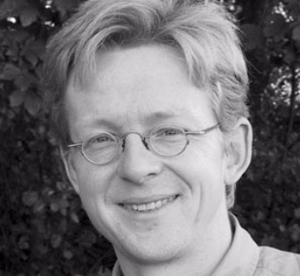
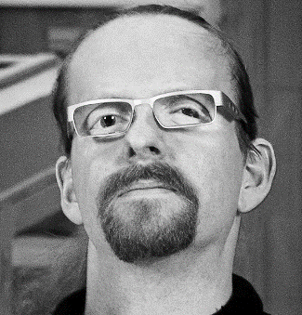

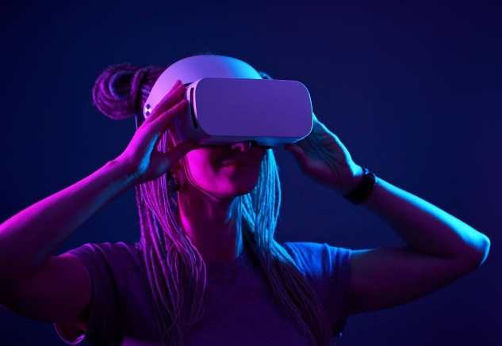
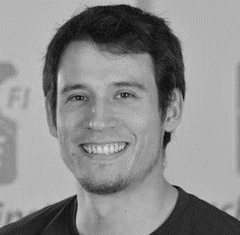
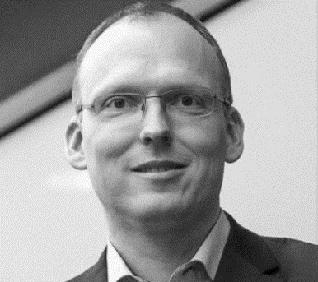

KAJ
MARIANNE
HANS
NIELS OLOF
KEN
HANS-JÖRG

Slide 3
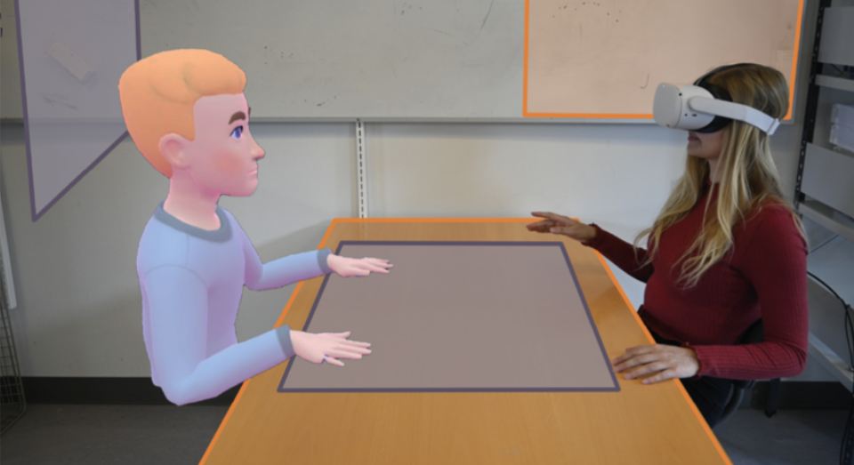
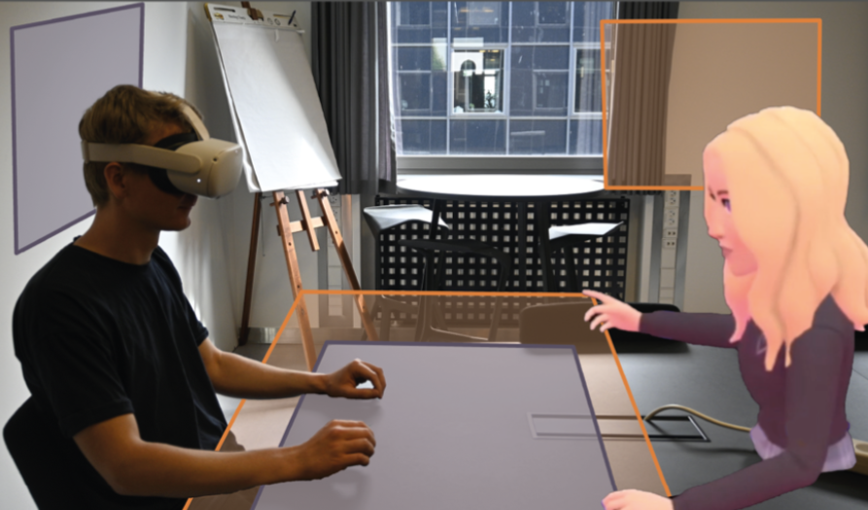
[UBI-A] Mixed Reality for Blended Collaboration
Blended Spaces through AR
collaboration across different locations
own environment incl. whiteboard and table
But spaces do not align
Meta Quest Pro

Slide 4
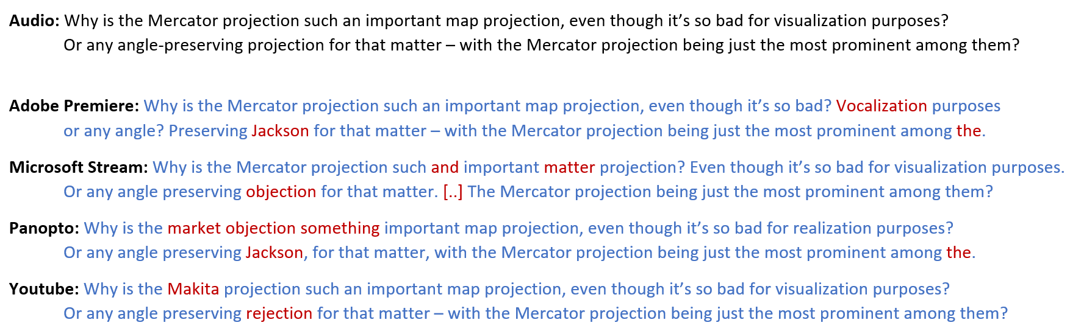
[UBI-L] Comparative Analysis and Visual- Interactive Merging of Video Subtitles

Slide 5
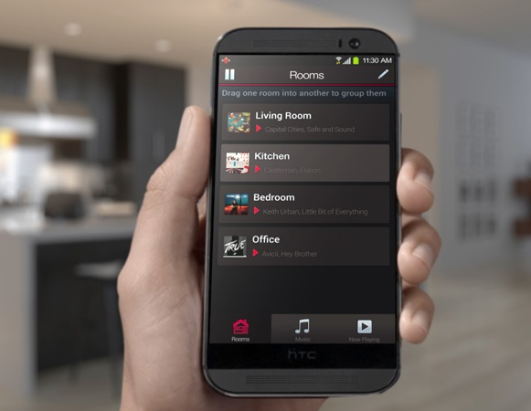
[UBI-N] Seamless Music Streaming
Transitions
Room to Room
Phone to Stereo
Playlist A to Playlist B
Sensors for spatial, temporal, and social context

Slide 6
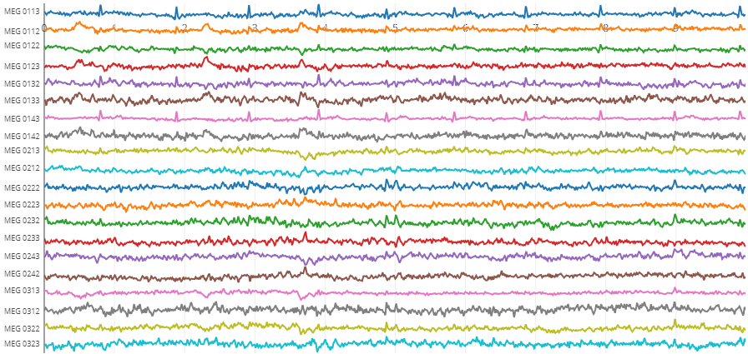
[UBI-F] Visual-Analytic Anomaly Detection and Correction of EEG Data

Slide 7
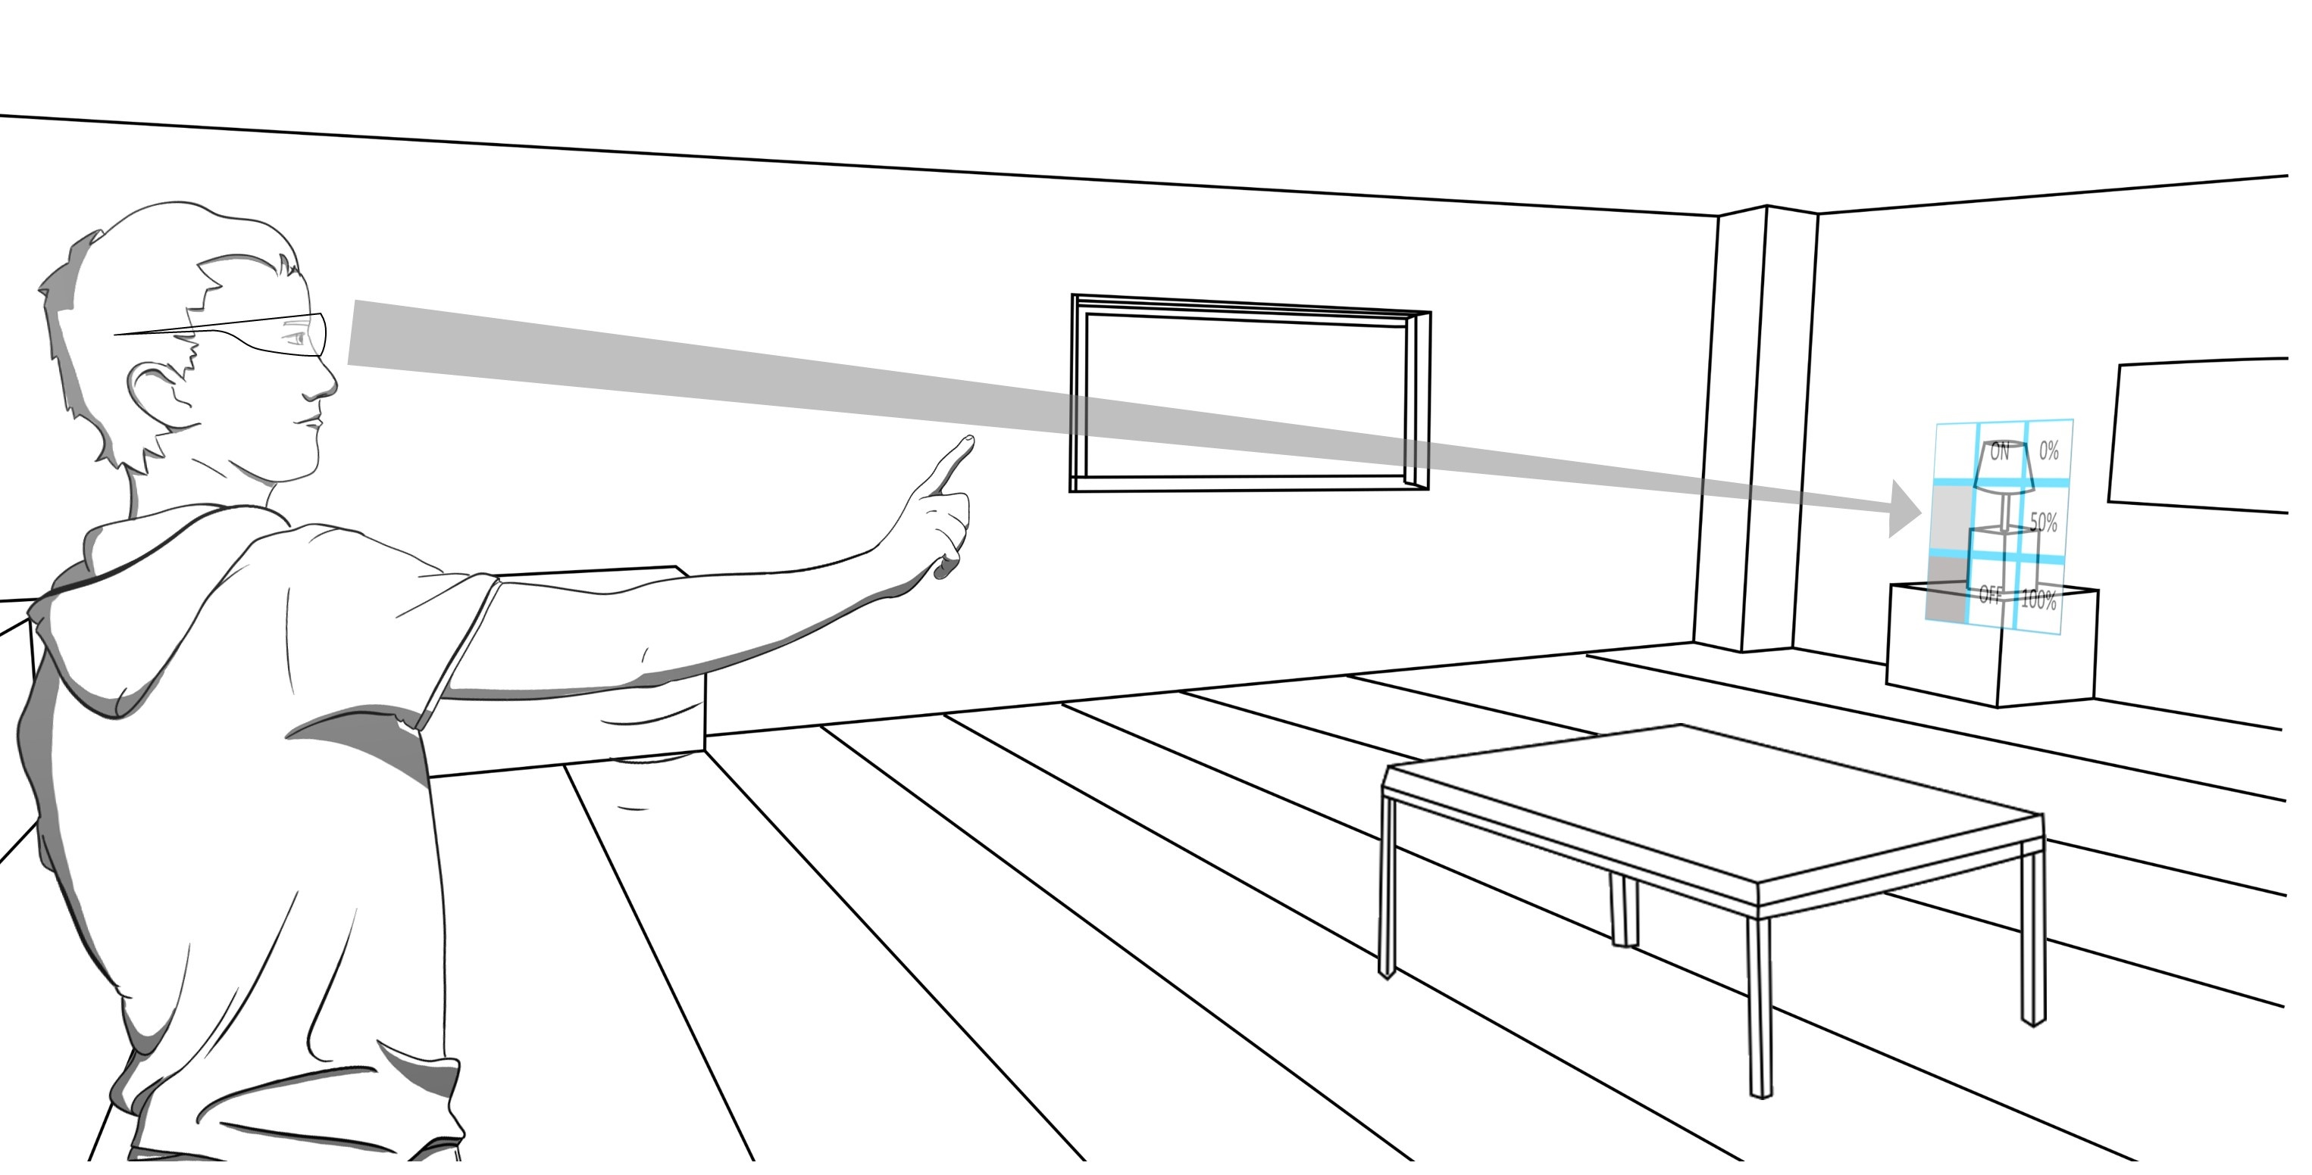
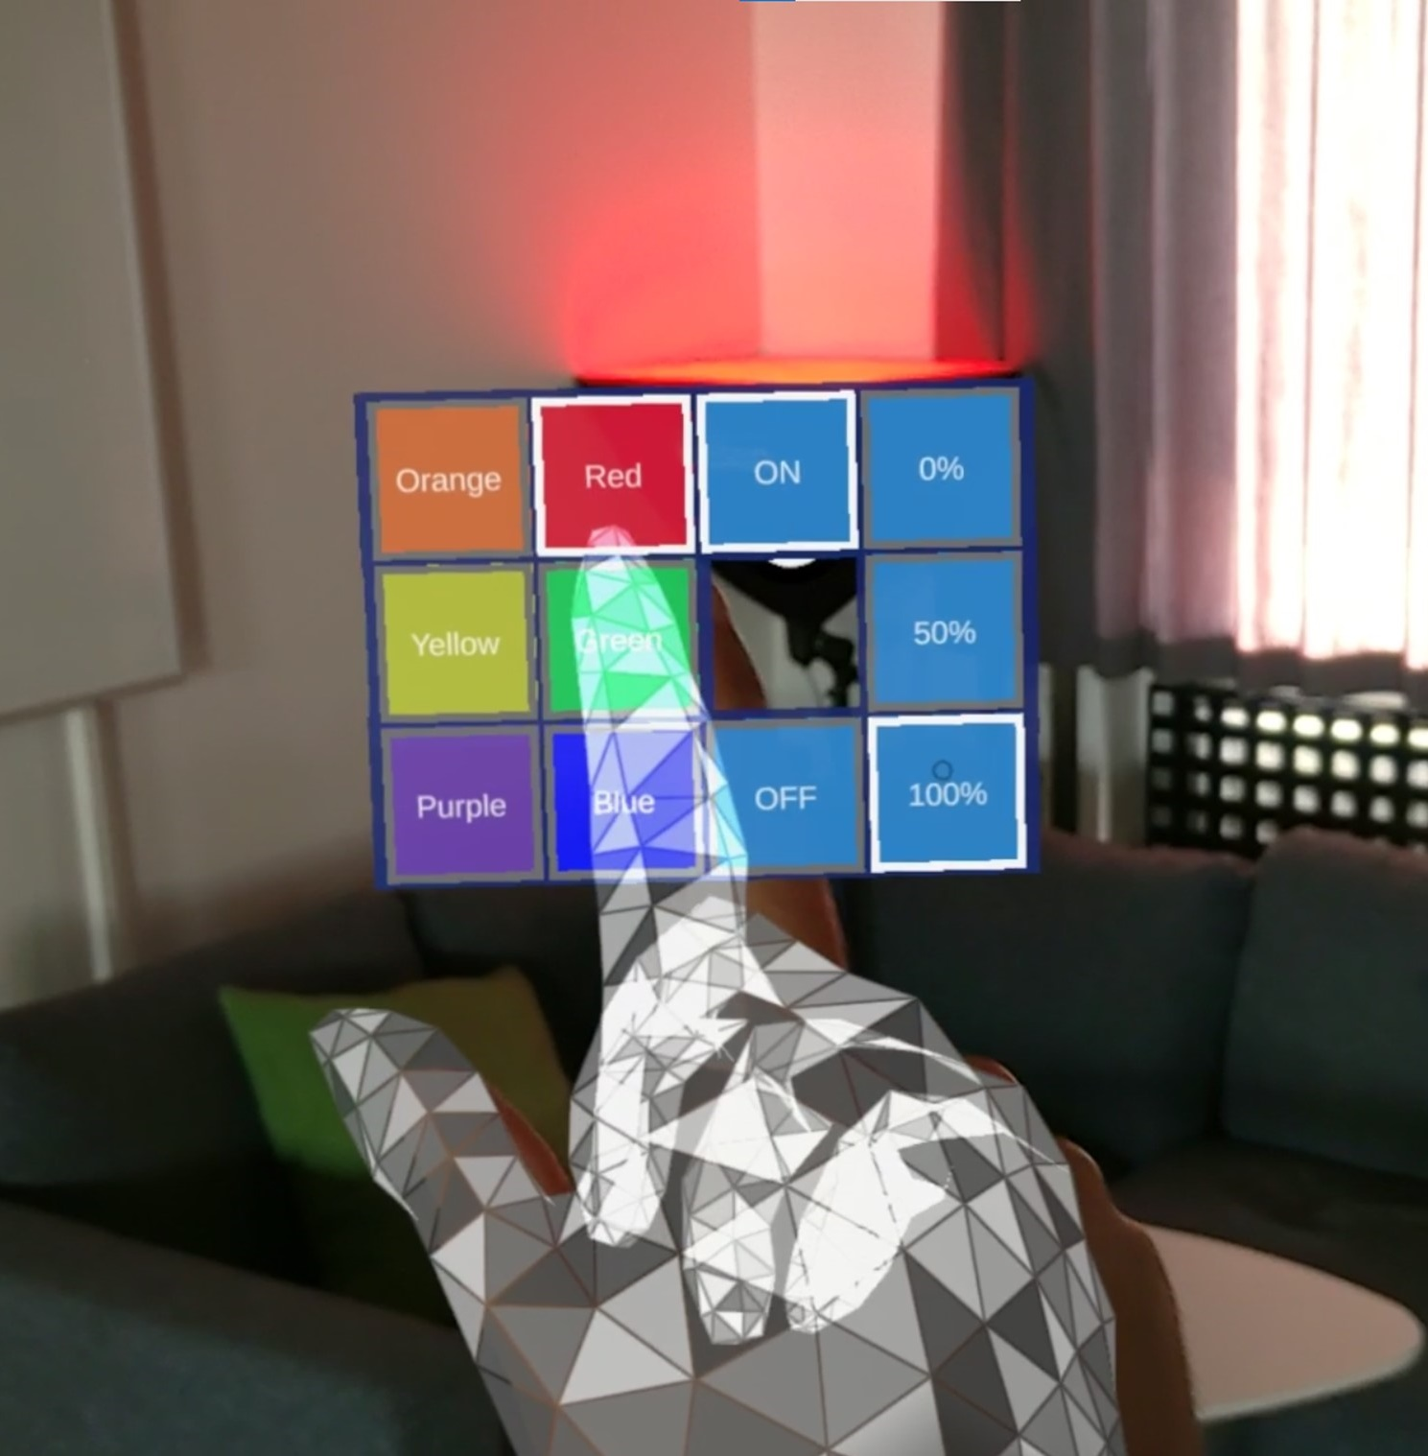
[UBI-E] Eye Based Interaction in AR
Combine Freehand Gestures & Eye Tracking to create novel interactions for:
Remote Manipulation
Drag & Drop in Space
Information Transfer through eye refocus

Slide 8
UBI BSc Projects
If you want to know more come to the information meeting right after or drop me an email at hjschulz@cs.au.dk.

